Slide 1
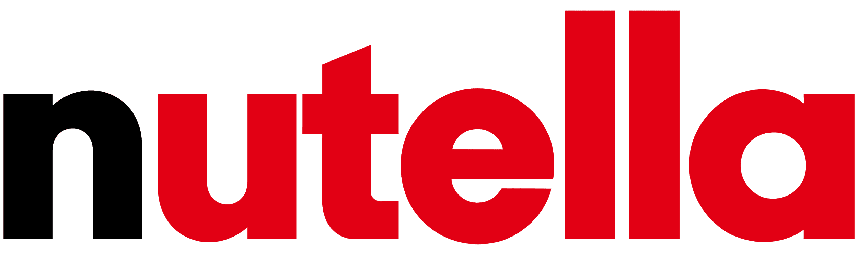
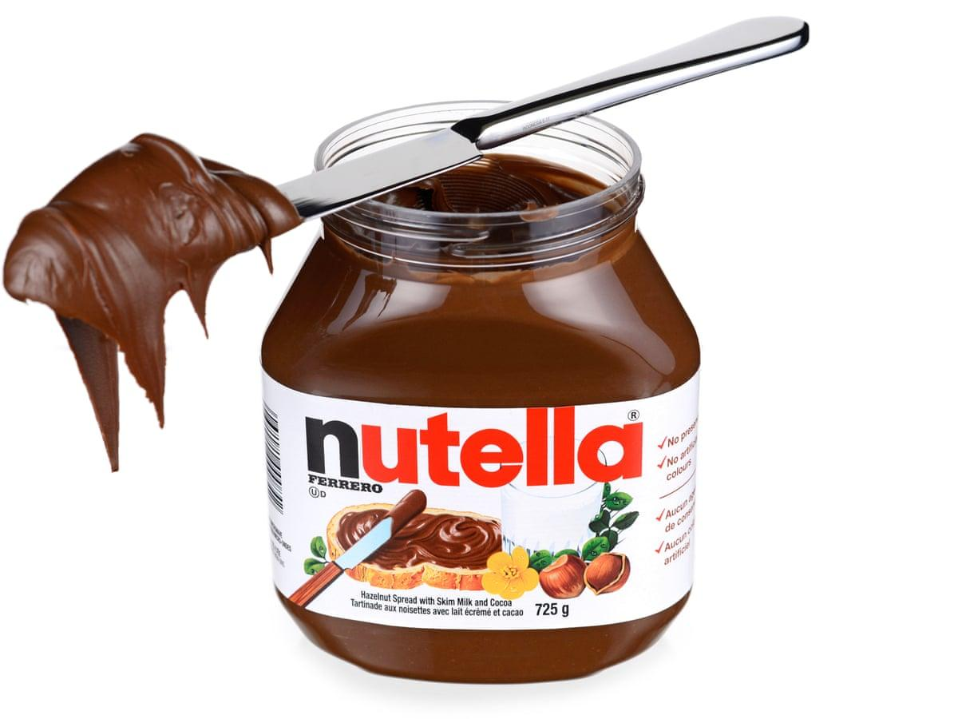
What makes people buy ?
Team 11
Sharvil Nawghare, Fabian Jaskotka, Giulio Marchesi, Phuong-Vy Nguyen,
Romchalee Aunsakulsaeree
Notes:
Introduction
Hello all, we are Team 11,

Slide 2




“You cannot make everyone happy; you aren’t Nutella!” We disagree and here’s why…
Analysis of who would
purchase Nutella
What business success
looks like
Actionable recommendations
are provided.
Make campaigns out of specific keywords/ grouped keywords
Notes:
Introduction
Hello all, we are Team 11, and today we are called in to present our analysis on how to purchase Nutella, and what business success looks like based on which actionable recommendations are provided. “You cannot make everyone happy, you aren’t nutella!”, we questioned that statement.

Slide 3
Shiny
Notes:
So we went on, designing a survey about morning routines, how people get to work and how their perfect days look like. In the end, we would always ask if the participant would buy Nutella or not. We then ran the survey across 34 people of diverse backgrounds. First of all, Nutella indeed is a very likeable product, 74% of respondents to be precise. After analyzing the answers, we found many interesting insights of which we want to highlight some.
Insights (present along Shiny dashboard)
We built a dashboard that summarized all gathered insights. For example….
<show correlogram on shiny> When comparing results from business success and business failure, words such as: hungry, cooking and bar gave business failures, while cheat and morning gave business success.
<show corr network on shiny> We also found words with the highest correlation to business success. It is interesting to notice how words like cereal and milk are connected suggesting that Nutella is perceived as a breakfast food but also the words pizza and chocolate are connected, suggesting that people are likely to try unusual ways of having Nutella such as a sweet chocolate pizza.
Based on these results, we developed a few actionable recommendations for Nutella to expand their product line with more distinct flavor combinations such as:
-Introduce a new product in the line: Nutella Cereal!
-Increase exposure on socials by leveraging trendy food hashtags and pages:
#pizzanutella #nutelladay #pizzanutellabanane
Introducing a different recipe with Nutella for the tiny jars collection
Customer can scan QR code to see more recipes to adapt with Nutella
<show sentiment analysis on shiny> From doing a sentiment analysis, we can observe the words associated with joy included perfect, beach, and sunny while the words associated with sadness were late, bad, and feeling.
<show Trigram analysis on shiny> Lastly, we found a few unique phrases that could bring great campaign ideas; these are clusters of word networks that are most commonly used together. For example:
“Chocolate, greasy, stuff, hamburgers, fries” → which can appeal to a common segment of customers , i.e. Fast Food Lovers & Young Teens/ Adults.
“Glazed, banana, whipped” → which can appeal towards festive treats and dessert food. This can be revealed: either by catering a product towards the key sentiments these words portray or launching a certain marketing campaign towards the same.

Slide 4
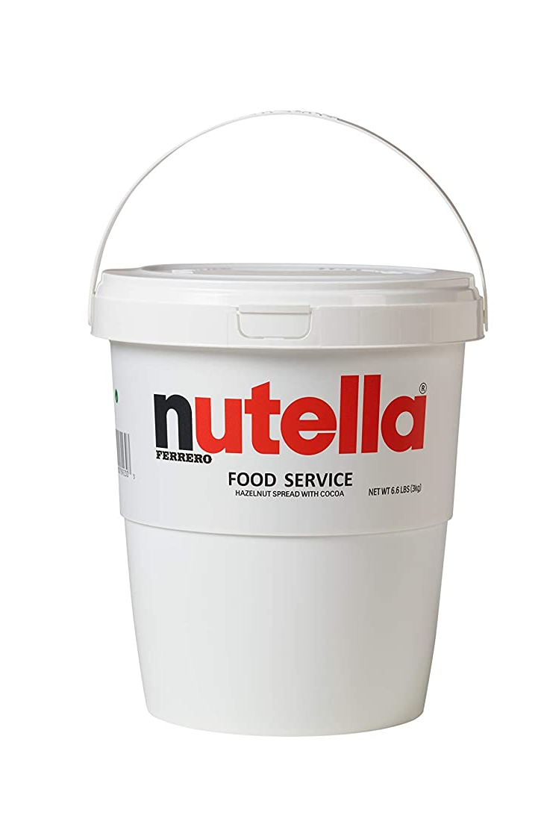
Refine Target Audience
Refine their target audience - people who are into cheat meals like gym rats or busy young adults, perceive Nutella as fast and easy snack.
Campaign #cheatday
#cheatday
Notes:
Based on our insights, we recommend the following:
Nutella should refine their target audience not to target people who are more likely to be into cooking at home and like to go to bars, but instead target people who are into cheat meals like gym rats or busy young adults recommending Nutella as a fast and easy snack.

Slide 5
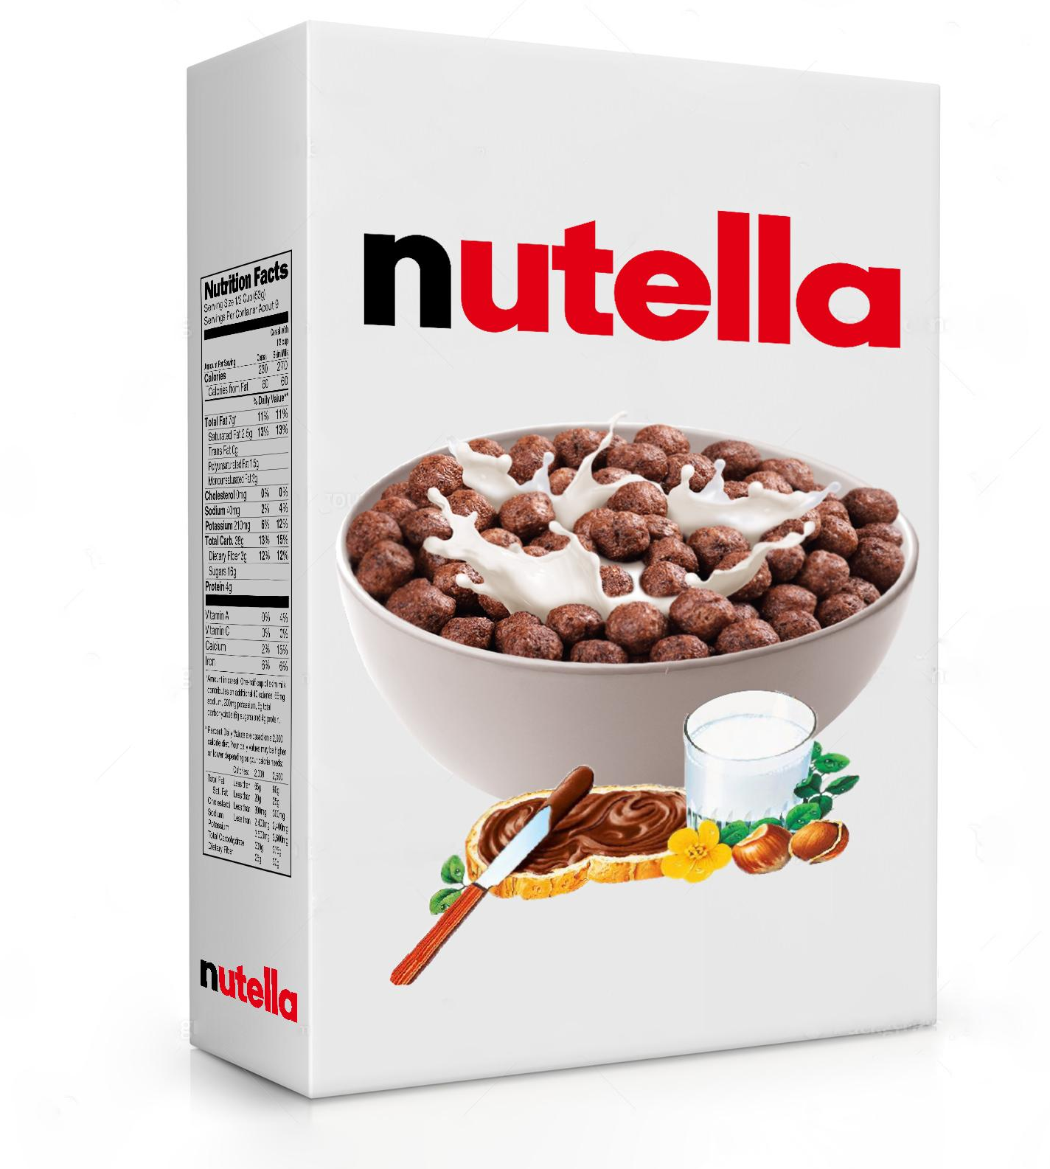
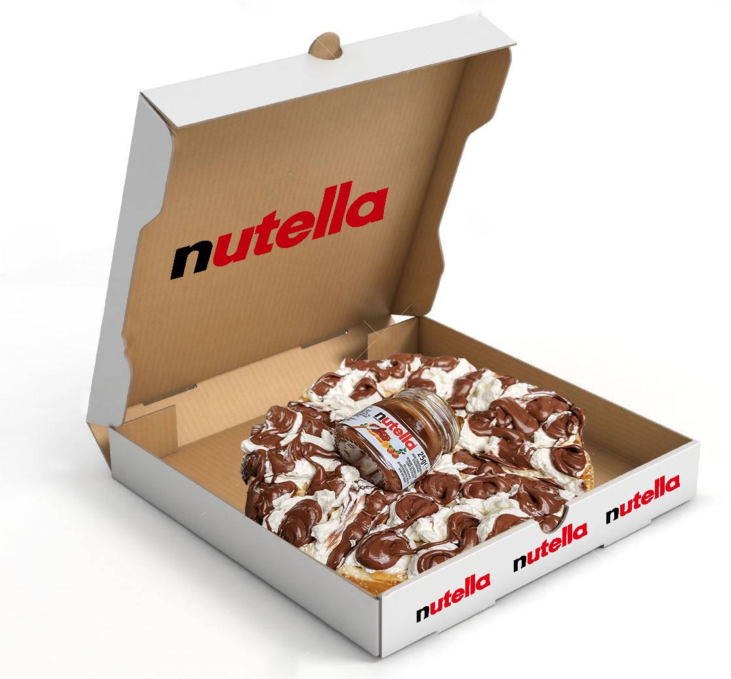
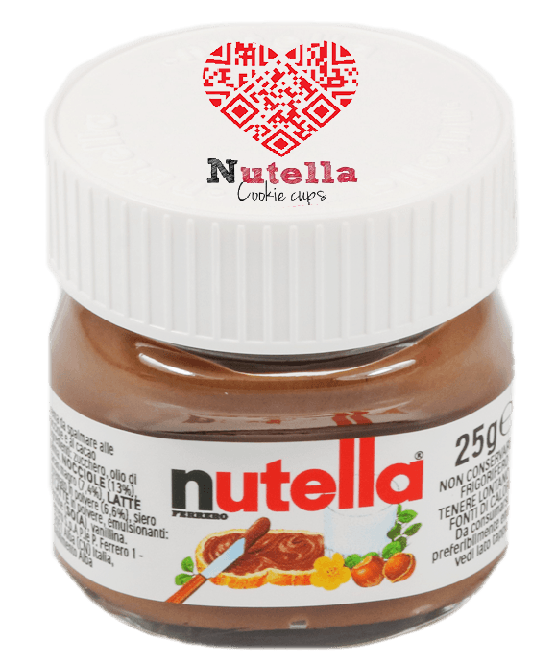
Introduce New Product Lines
New product line: Nutella Cereal
Increase exposure on socials with trendy food hashtags: #pizzanutella #nutelladay #pizzanutellabanana
Introducing a different recipe with Nutella for the tiny jars collection (QR code recipe)
Notes:
Nutella can expand their product line with more distinct flavor combinations such as:
Introduce a new product line: Nutella Cereal!
Increase exposure on socials with trendy food hashtags and pages: such as #pizzanutella #nutelladay #pizzanutellabanana
And Introduce a different recipe with Nutella for the tiny jars collection, and Customer can scan QR code to see more recipes to adapt with Nutella

Slide 6
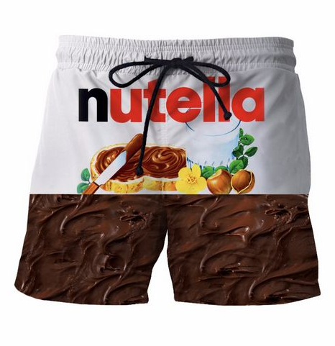
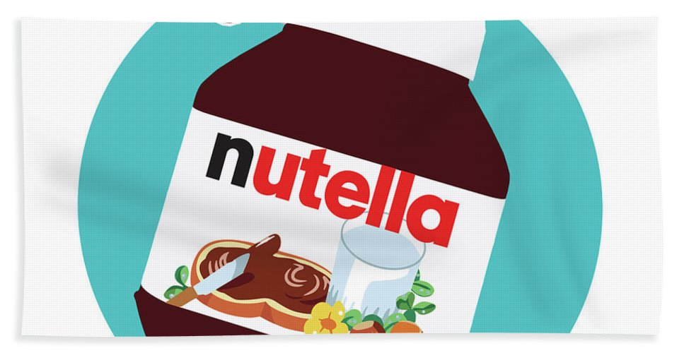
Revamp Old Campaigns
Update ‘wake up with nutella campaign’ & ‘morning campaign’:
Adopt joy keywords to link with advertising campaign ideas
Create a narrative story of “a perfect sunny day to spend time on the beach and having a taste of sweet chocolate and hazelnut.”
Notes:
Sentiment analysis
From sentiment analysis, we can observe the words associated with joy including perfect, beach, and sunny while the words associated with sadness are late, bad, and feeling. Therefore, we suggest Nutella to avoid using those sad words with any future marketing campaign. We recommend Nutella to adopt joy keywords to link with advertising campaign ideas. To revamp and develop from the old campaign like ‘wake up with nutella campaign’ & ‘morning campaign’, Nutella can create a narrative story of a perfect sunny day to spend time on the beach and having a taste of sweet chocolate and hazelnut.

Slide 7
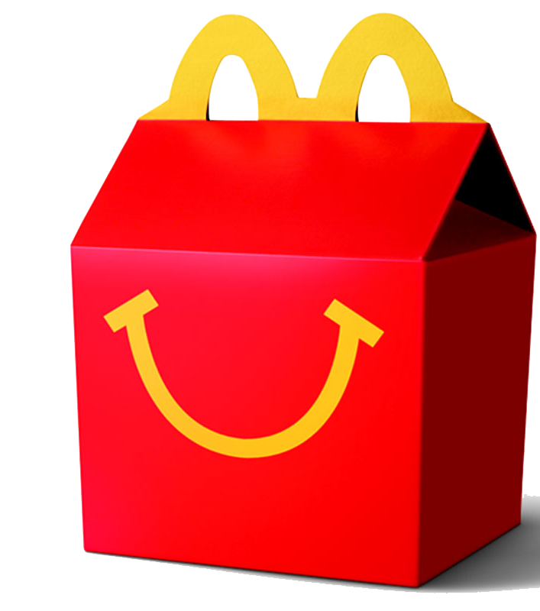
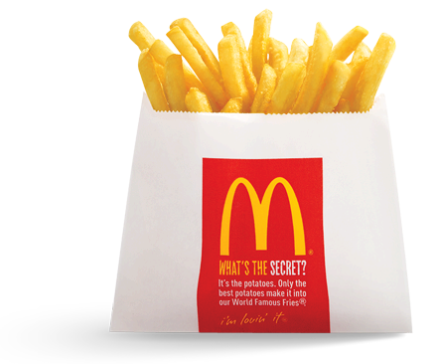
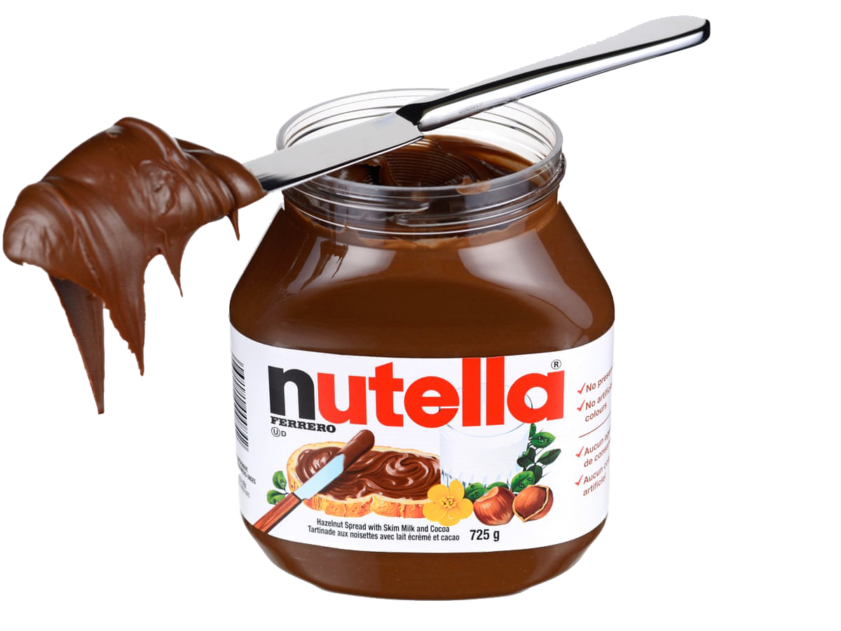
Tap Into themed Celebrations
Partner with McDonalds And add Nutella to happy meal “Fries with Nutella”
Notes:
With phrase like ‘chocolate, greasy, hamburgers, and fries’ we recommend a partnership with (any) fast food chain to cross sell by including nutella to their menu for e.g. Partner with McDonald's → add nutella to a happy meal, or nutella fries (It’s better than finger lickin’ good!).

Slide 8
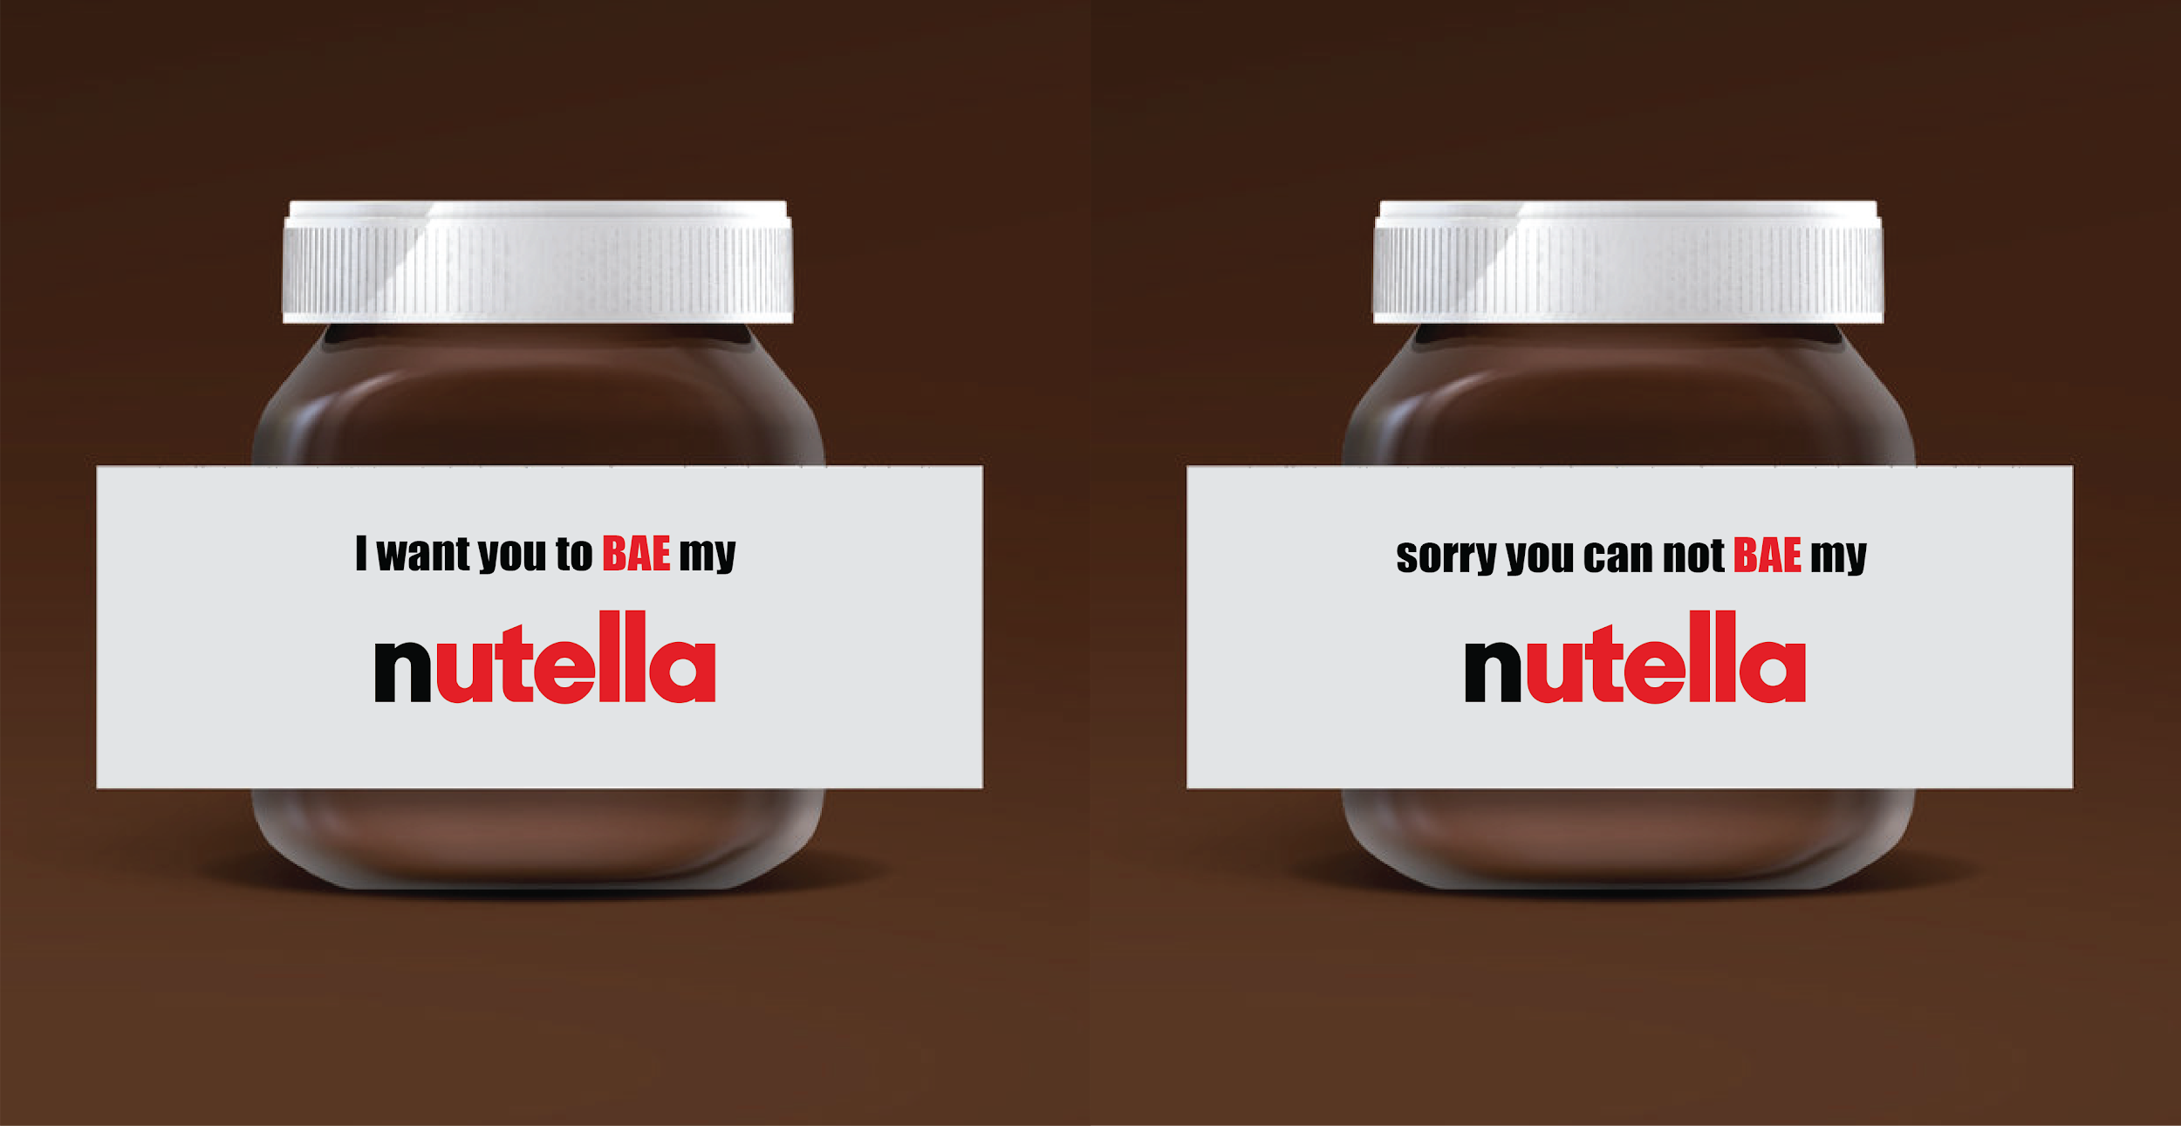
Tap Into themed Celebrations
Launch a Valentine’s Day themed campaign (trigram phase 2)
Feb 13: Bae-up with Nutella Feb 15: Breakup with Nutella
Notes:
Lastly, with phrase like ‘glazed banana whipped’, we recommend launching a Valentine’s Day themed campaign appealing towards the sentiment of joy and celebration with a bold theme:
For example: on Feb 13: Bae-up with Nutella - Small packets with different names, if your crush's name is on the box, ask them out for v’day with a nutella twist. (Combo of nutella and pizza) hey they made it work, so can you!!
Feb 15: breakup with Nutella -- The date wasn’t as sweet as Nutella, Bummer! But worry not, break-up over a Nutella and leave them satisfied with the nutella pizza!

Slide 9
Conclusion
Recap of Recommendations:
Refining it’s target audience
Introducing new product lines
Increase exposure on socials by leveraging trendy food hashtags
Revamping old campaigns
Tapping into themed/ seasonal celebrations for greater benefits
Notes:
Conclusion
We strongly believe the future of Nutella relies on:
Refining it’s target audience
Introducing new product lines
Increase exposure on socials by leveraging trendy food hashtags
Revamping old campaigns
Tapping into themed/ seasonal celebrations for greater benefits
Without a doubt, if we turn recommended ideas into fruition, we guarantee, people will go NUTS for Nutella.
Please feel free to explore our analysis for yourself in the Dashboard we build for you.

Slide 10
GO NUTS FOR NUTELLA

